Slide 1
KRISHI MITRA
A Platform For Farmers And Traders

Slide 2
TEAM INFORMATION
TEAM MEMBERS:
DHEERAJ SONI(TEAM LEADER)-
Bidding Module, Farmer Module
SHWETA YEOLE-
Farmer Module, Admin Module
UPANITA KUMARI-
Front End, Farmer Module, Admin Module
SOFIA FRANCIS-
Login, Registration, Front end, Admin Module

Slide 3
PROBLEM STATEMENT
Krishi Mitra is a project in Agriculture domain which helps the farmers to sell their products online from different cities through the process of bidding. Farmers can use this facility and avail benefits of different schemes available which will increase their profit.

Slide 4
OBJECTIVES
To encourage farmers to adopt innovative and modern agricultural practices.
To ensure flow of credit to the agriculture sector.

Slide 5

GLIMPSE OF THE PROJECT

Slide 6
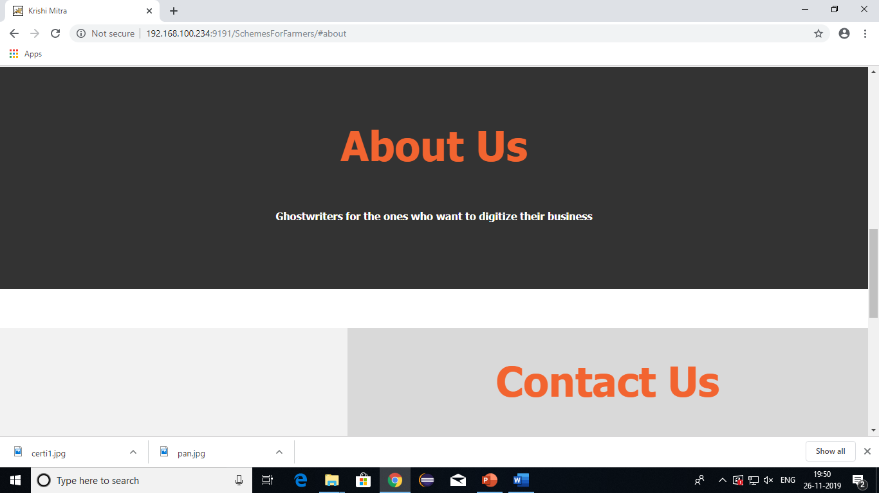

Slide 7
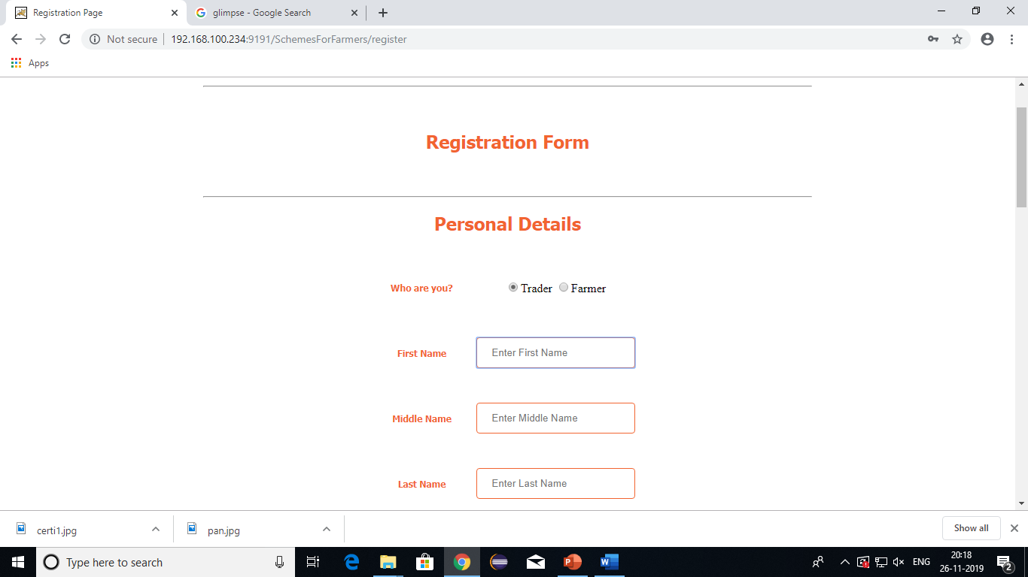

Slide 8
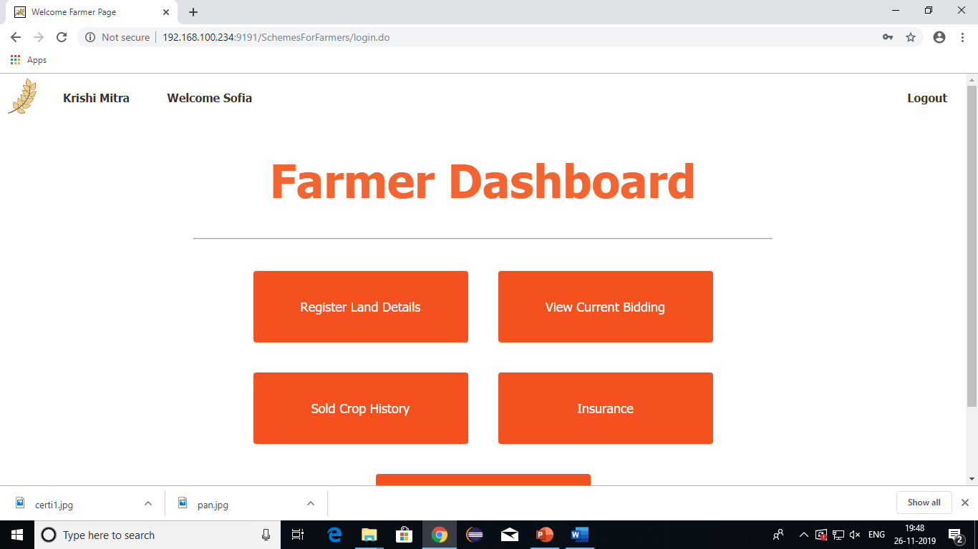

Slide 9
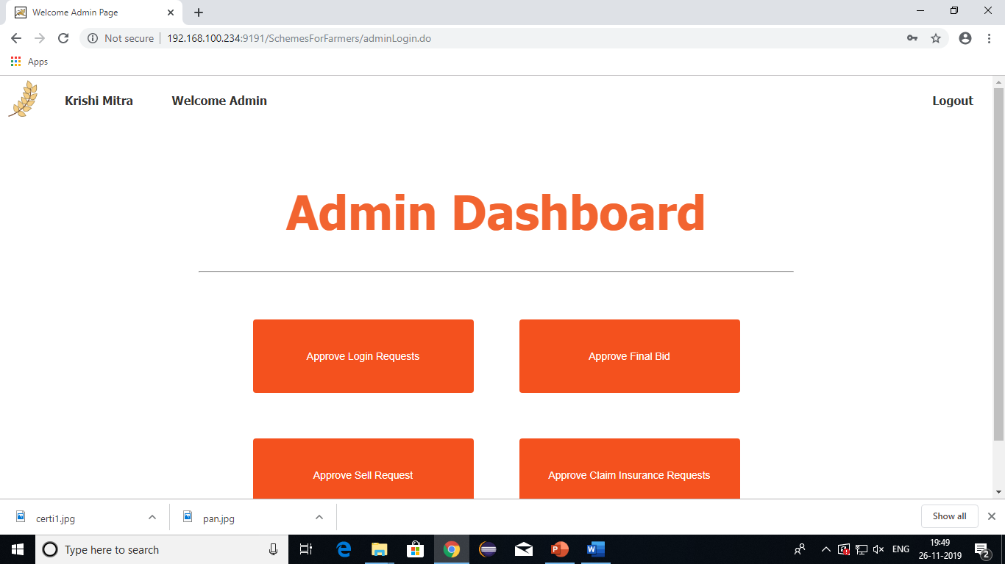

Slide 10
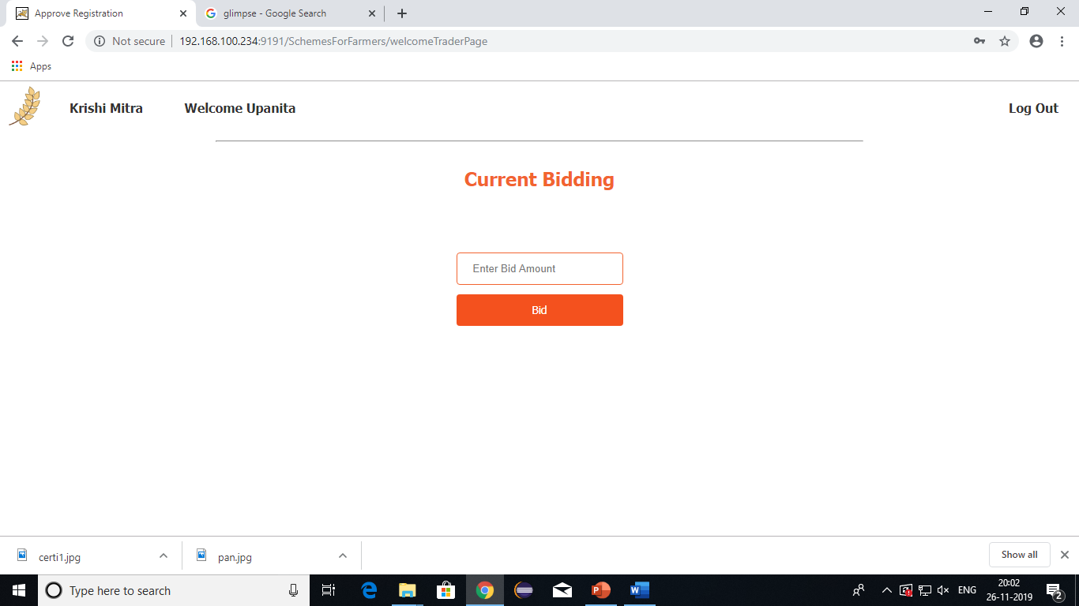

Slide 11
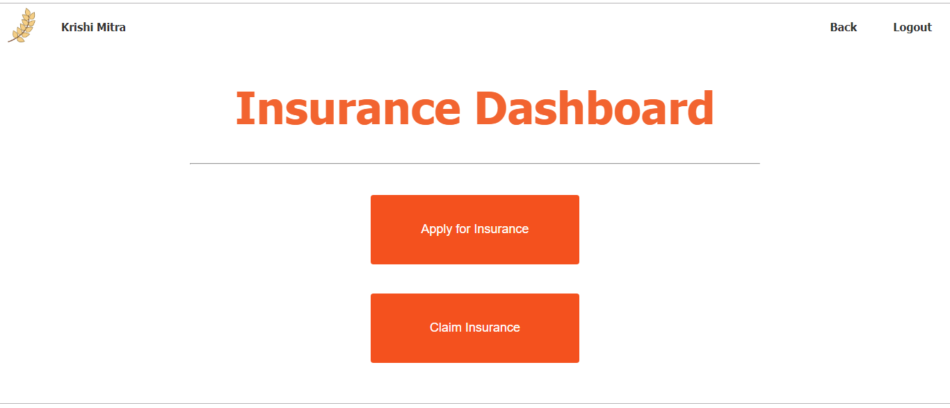

Slide 12
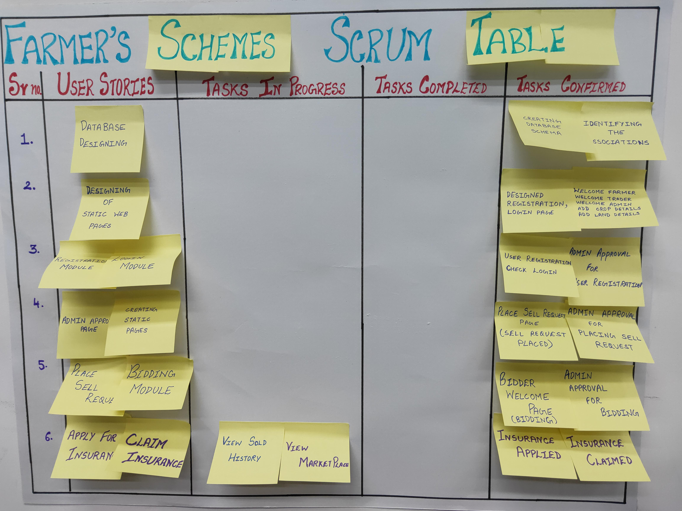
SCRUM TABLE

Slide 13
CONCLUSION
The Project will enable the farmer to get best schemes for insurance and bidding, place crops for auction and receive best price from auction which would help the farmers in their stabilization of income as well as will eliminate the stress of physical sale of crops in the market.

